Slide 1
Serverless APIs
Deploy an App: No Servers Required!
Mike Rosack | mike@rosacksoftwaresolutions.com | @mike_rosack
github.com/mrosack/presentations

Slide 2
Agenda
The Journey to Serverless
High level demos of AWS Lambda and the Serverless Framework as an API backend
Serverless Pros & Cons
Discussion on Serverless Architectures

Slide 3
The Journey to Serverless Chapter 1: Buy a bunch of VMs (IaaS)
IT WAS GOOD!
Only need to pay for hardware when you’re using it, save money during slow seasons
Able to have servers distributed across different regions for fault tolerance
BUT…
You have to manage the VMs yourself and keep them patched, that’s a real pain!
You need to figure out how and when to scale them up and down!

Slide 4
The Journey to Serverless Chapter 2: Deploy to Sandboxes (PaaS)
IT WAS GOOD!
Don’t have to worry about patches/updates any more, the cloud provider takes care of that!
BUT…
You still need to configure autoscaling groups and plan how to accommodate traffic bursts and lulls.
Spinning up a new instance isn’t instantaneous, so you need some spare capacity.

Slide 5
The Journey to Serverless Chapter 3: SPA Front Ends
IT WAS GOOD!
Your SPA front end can just be deployed statically somewhere (S3/Cloudfront) – No need to worry about how it’ll scale (other than cost).
BUT…
You’ve still got that pesky PaaS backend – it’s OK, but…

Slide 6
What If?
We could just deploy our code somewhere, like we do with PaaS Sandboxes…
But those sandboxes could be spun up and down automatically, on demand, for any usage scenario?

Slide 8
Serverless Computing (FaaS)!
Abstracts away computing power from the server used to execute it.
Pay per execution, not per server.
Can scale as large as the limit on your credit card, instantaneously, with no brainpower required.

Slide 9
Writing a Serverless Function
Trigger: Something that triggers the function to run (HTTP Request, queue message, blob appearing)
Execute Function: Execute code linked to trigger – usually Javascript, but both AWS and Azure support Python, C# and other languages
Output: A function doesn’t necessarily need output, but in certain circumstances output needs to be returned to the caller.

Slide 10
Triggers
API Gateway (HTTP)
Streams
S3
Schedule/Cron
SNS
Alexa
IoT Message
DynamoDB
SES
Cognito
Etc…

Slide 11
Pricing
Both AWS & Azure
$0.20/million executions (1 million free)
$0.06/GB-hour of execution time
Request between 128 and 1536 MB
More memory = faster CPU
AWS API Gateway: $4/million requests
Azure Hybrid model (run functions code on reserved hardware)

Slide 12
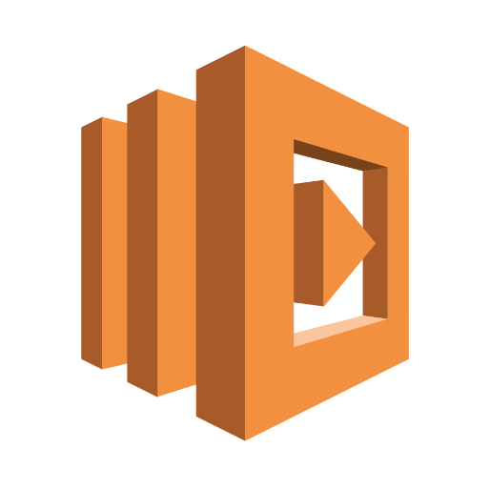
DEMO: AWS Lambda

Slide 13
That was fun, but…
How do you manage devops?
What if I want to debug locally?
I want to test before I deploy, right?

Slide 14
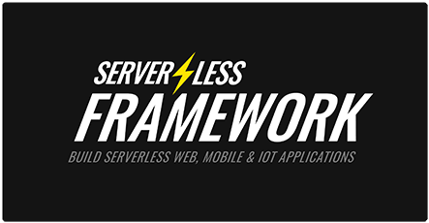
Serverless Framework
Initially built on top of AWS Lambda & CloudFormation
Recently added support for Azure and IBM OpenWhisk
Large community, lots of plugins
Local development support (through plugin)

Slide 15
DEMO: Serverless Framework

Slide 16
Downsides to Serverless
Pay per request can be an issue depending on pricing (AWS is worse than Azure right now)
Functions can’t run forever (max 5 minutes on both AWS and Azure)
“Fanout” pattern can be used to get around this somewhat
No out of the box way to do Websockets
You could technically long-poll if you wanted to pay for it…
Cold Starts!

Slide 17
Serverless Architectures
Microservices (or Nanoservices? one function per operation – GET, POST, DELETE, etc)
Lots of cold starts
Run into CloudFormation limits (may be AWS only)
Services (one function per logical group of operations)
Monolithic (one function hosting entire restful API)
GraphQL (one function hosting entire GraphQL API)
https://serverless.com/blog/serverless-architecture-code-patterns/

Slide 18
Go Monolith! “Micro” isn’t always better…
Especially for smaller applications, cold starts can be a real issue
CloudFormation limits will probably be worked around at some point in time, but for now they’re a massive hassle
Designing your application so it works in a single lambda makes it much more portable
Save your functions for backend processing!

Slide 19
DEMO: TSOA Serverless Monolith
https://github.com/mrosack/tsoa-serverless-example

Slide 20
Thank You!
Mike Rosack
@mike_rosack
mike@rosacksoftwaresolutions.com
github.com/mrosack/presentations

